Slide 1
X
AdiLogi
Where Industrial Intelligence Meets Interface.
X
AdiLogi
Where Industrial Intelligence Meets Interface.
X
AdiLogi
Where Industrial Intelligence Meets Interface.
X: Font :Broadway 54 size
AdiLogic: Font: Calibri 36 Size
Tag Line: Calibri 18
AdiInfi Logo Blue Color: #1589CB
AdiInfi Logo Orange Color: #CA7C42

Slide 2
X
AdiNe
us
The Pulse Between Edge and Cloud.
X
AdiNe
us
The Pulse Between Edge and Cloud.
X
AdiNe
us
The Pulse Between Edge and Cloud.
X: Font :Blanka-Regular 54 size
AdiLogic: Font: Calibri 36 Size
Tag Line: Calibri 18
AdiInfi Logo Blue Color: #1589CB
AdiInfi Logo Orange Color: #CA7C42

Slide 3
X
AdiRMS-VPN
AdiCloud
Your Industrial IoT Cloud for Smarter Operations
X
AdiCloud
Your Industrial IoT Cloud for Smarter Operations
X
AdiCloud
Your Industrial IoT Cloud for Smarter Operations
X: Font :Broadway 54 size
AdiLogic: Font: Calibri 36 Size
Tag Line: Calibri 18
AdiInfi Logo Blue Color: #1589CB
AdiInfi Logo Orange Color: #CA7C42

Slide 4


Power
Power
Power
The Pulse Between Edge and Cloud
Power
Power
Power
ADIGW-33901 V 1.0
Power: 5-24V DC

Slide 5


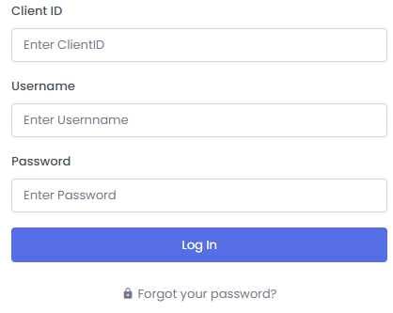
Your Industrial IoT Cloud for Smarter Operations
Cloud SCADA
Cloud HMI
Reports
© 2025 Crafted by AdiInfi Private Limited
Analytics
Industrial Revolution
IIoT Platform
Next Gen
Trending Chart
Historian
Real Time

Slide 6


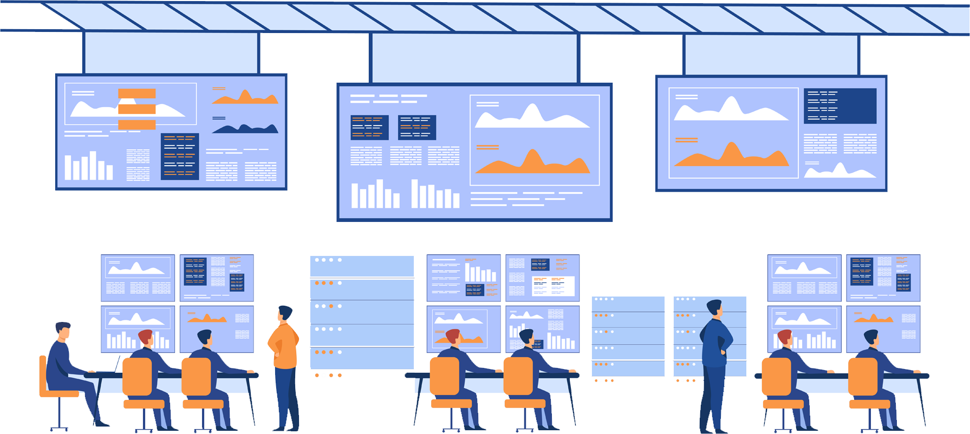


Made In India
Market Leader
IIOT Platform
Cloud HMI
Cloud SCADA
Your Industrial IoT Cloud for Smarter Operations
© 2025 Crafted by AdiInfi Private Limited
Adilogix is a modern SCADA platform designed for real-time control, intelligent monitoring, and seamless automation across industrial environments. Built in India for the world, it offers flexibility, performance, and ease of use—empowering teams to build, scale, and optimize operations with confidence. Read More…
AdiNexus is a next-generation IoT gateway engineered to seamlessly connect machines, sensors, and enterprise systems into one intelligent network. Designed for reliability and scalability, it bridges the gap between field devices enabling secure data exchange, edge intelligence, and real-time decision-making. Read More…

Slide 7

Your Industrial IoT Cloud for Smarter Operations
Cloud SCADA
Cloud HMI
Reports
© 2025 Crafted by AdiInfi Private Limited
Analytics
Industrial Revolution
IIoT Platform
Next Gen
Trending Chart
Historian
Real Time

Slide 8


Template Designer
Tile Designer
dashboard Designer
Report Designer
Plant Designer
Controller Designer
Filer Designer
Dialog Box Designer
Alarms

Slide 9
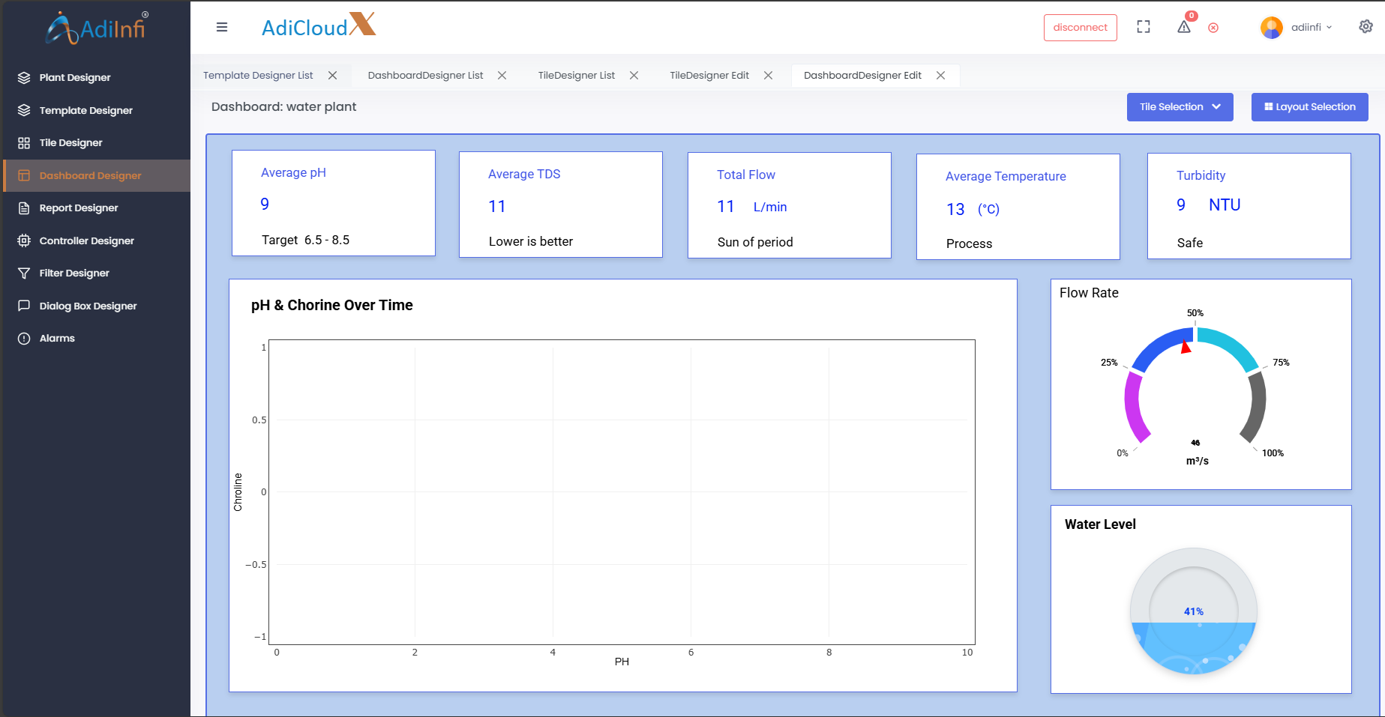
[ V 1.0.0 ]
Template Designer
Tile Designer
dashboard Designer
Report Designer
Plant Designer
Controller Designer
Filer Designer
Dialog Box Designer
Alarms

